Slide 1


Introduction to Test-Driven Development
Philadelphia Winter 2011
Alex Hung
CTO
Ballyhoo Software

Slide 2
Agenda
Why Test-Driven Development?
What is It?
Demo & Lab

Slide 3

Why Test-Driven Development is “agile”?
Transmission change ~= days
Notes:
“How would I use that method?”

Slide 4

Why Test-Driven Development is “agile”?
Transmission + rear suspensions + rear subframe change ~= 3.5 hours!
Notes:
“How would I use that method?”

Slide 5

How is Test-Driven Development “agile”?
Not Designed for change!
Designed for change!
Transmission change ~= days
Transmission + rear suspensions + rear subframe change ~= 3.5 hours!
Notes:
“How would I use that method?”

Slide 6
How is Test-Driven Development “agile”?
Ability to responds to change
TDD allows code to be changed/refactored quickly, easily, and safely in response to change in requirement, architecture, etc.
Notes:
“How would I use that method?”

Slide 7
How is Test-Driven Development “agile”?
Feedback on change
TDD provides quick feedback on code changes, especially non-obvious, unexpected effect.
Notes:
“How would I use that method?”

Slide 8
The Rationale for Unit Tests
Non-Debatable Software Engineering Facts:
There will always be bugs
Complex programs have more bugs than simple programs
Code is more maintainable when its divided into bite-sized chunks
The cost of fixing a bug escalates non-linearly over time as the project progresses

Slide 9
‘Code Complete’ Defect Cost Graph

Slide 10
What is Unit Testing?
Primary purpose is to test public interface of one or more classes
As Isolated as possible (hence ‘unit’)
Independent of other system components
If your test touches something else you didn’t develop but your app depends on to run (database, web service, etc.) then it’s not a unit test
Sandboxed
No side-effects to the environment allowed
Typically run via a unit test framework (NUnit, MbUnit, etc.)

Slide 11
What is Test-Driven Development?
Testing while coding
not before or after

Slide 12
What is Test-Driven Development?
Think “Test-Driven Design”
or
“Specification-Driven-Development”
Consider your design from the perspective of the consumers of your methods, classes, etc.
Outside-In design instead of Inside-Out design
Notes:
Insider-Out design = write the code, decide what the method signature will looks like based on what the code requires. Then somehow makes it work with other classes
Outside-In design = decide what you want the class to do (i.e. the concept, inputs, outputs), then write the code that satisfies the requirement.

Slide 13
What is Test-Driven Development?
“How-Do-I-Use-This-Driven-Development”
For every line of code you write, ask yourself a simple (but powerful) question:
“HOW WILL I TEST THAT?”
Notes:
“How would I use that method?”

Slide 14
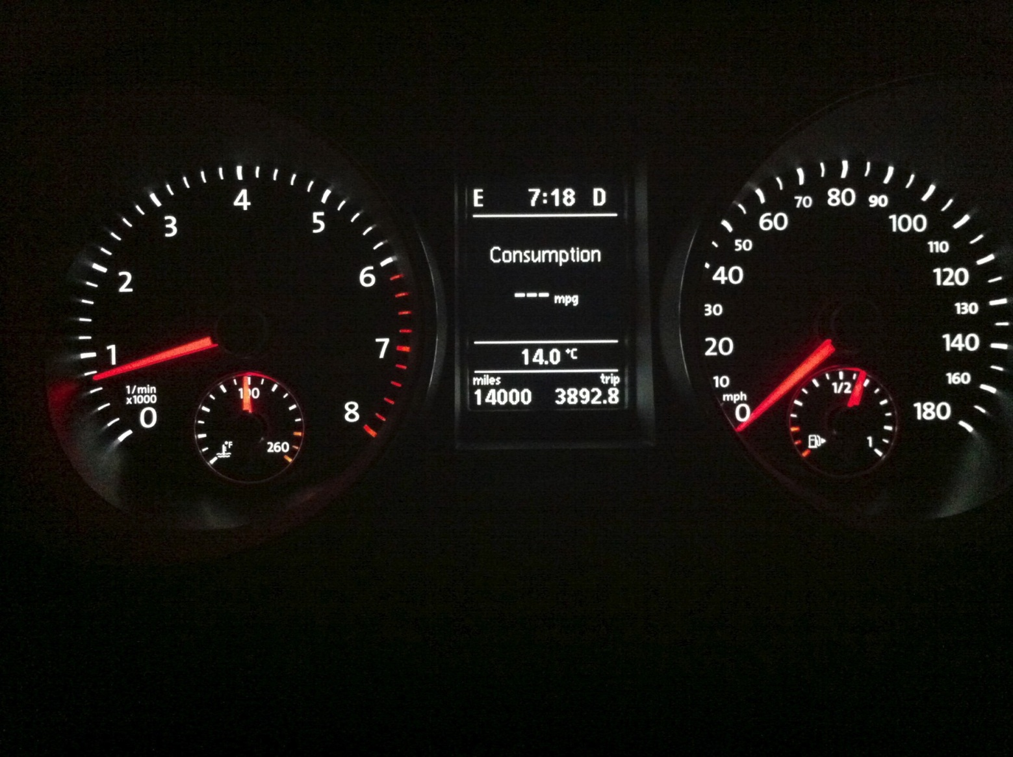
Code example
Wait, why do you mean by that?!

Slide 15
Benefits of TDD
Every class and method immediately has at least two consumers:
Your app and your test!
Better-isolated code leads to easier to extend, enhance, replace, maintain (lifecycle costs)
Notes:
Many design issues can be uncovered by the simple fact that your classes are being consumed by more than one consumer. Code is no longer a ‘one-off special’.

Slide 16
Benefits of TDD
Less likely to write code that you eventually don’t need
Write nothing that you think you will need
(YAGNI – You Ain’t Gonna Need It!)
Waiting until code is written to write the tests often means hard (impossible?) to test code!

Slide 17
Our First Test
Enough talking, let’s write some code!

Slide 18
Unit Test Flow
Once before any tests are run
Test Fixture SetUp
Test SetUp
Once before each test is run
Test
Once after each test is run
Test TearDown
Once after all tests are run
Test Fixture TearDown

Slide 19
Ping-Pong Pair Programming
Developer 1
Developer 2
Two heads are better than One
Writing code isn’t the time-consuming part,
Thinking about what to write is!
Write a failing test
Write code to get it to pass
Write code to get it to pass
Write the next failing test

Slide 20
Ping-pong demo
Let us show you how that’s done

Slide 21
The Process
RED
GREEN
REFACTOR
…mercilessly!

Slide 22
Calculating primes
Coding Lab

Slide 23
Problem Statement
Calculate Prime Numbers between 1-10,000
A positive integer divisible only by 1 and itself
By definition, 0 and 1 are non-prime
Write results to the console as follows:
Multiple lines of 5 comma-separated values each
Every 10 lines, insert a line indicating the count of the primes output thus far
2,3,5,7,11
n,n,n,n,n
n,n,n,n,n
n,n,n,n,n
n,n,n,n,n
n,n,n,n,n
n,n,n,n,n
n,n,n,n,n
n,n,n,n,n
n,n,n,n,n
Count: 50
n,n,n,n,n
n,n,n,n,n
….

Slide 24
Write a Failing Test
Get it to Pass
Refactor!

Slide 25
Now GO!
Find someone to pair with
Decide on features to implement
Write the test
Get test to green
Rinse & Repeat
Remember: Failure IS an option!

Slide 26
Ways to think about Unit Testing
Unit Testing is…
An alternative to spending your life in the debugger
A way to validate that your code is aligned with your intent
‘it compiles’ is a validation of the syntax of your code
‘it passes the unit tests’ is a validation of the behavior of your code

Slide 27
Ways to think about Unit Testing
Unit Testing is…
An hedge against future bugs
Prevents regression bugs (oops, I broke it!)
A safety-net that allows you to experiment with your design
‘What-if’ can be safely explored
No code is ‘hands-off for fear of something breaking’

Slide 28
Ways to think about Unit Testing
Unit Testing is not…
Going to save you any time in the project
…until someone changes the project requirements ☺

Slide 29

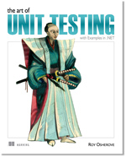
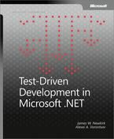
Philadelphia Winter 2011
Test-Drive Development: By Example – Kent Beck
http://amzn.com/0321146530
The Art of Unit Testing – Roy Osherove
http://amzn.com/1933988274
Test-Drive Development in Microsoft .NET – James Newkirk,
Alexei Vorontsov
http://amzn.com/0735619484

Slide 30
Questions?
Philadelphia Winter 2011
Twitter: @AlexHung
alex.y.hung@gmail.com

